Slide 1
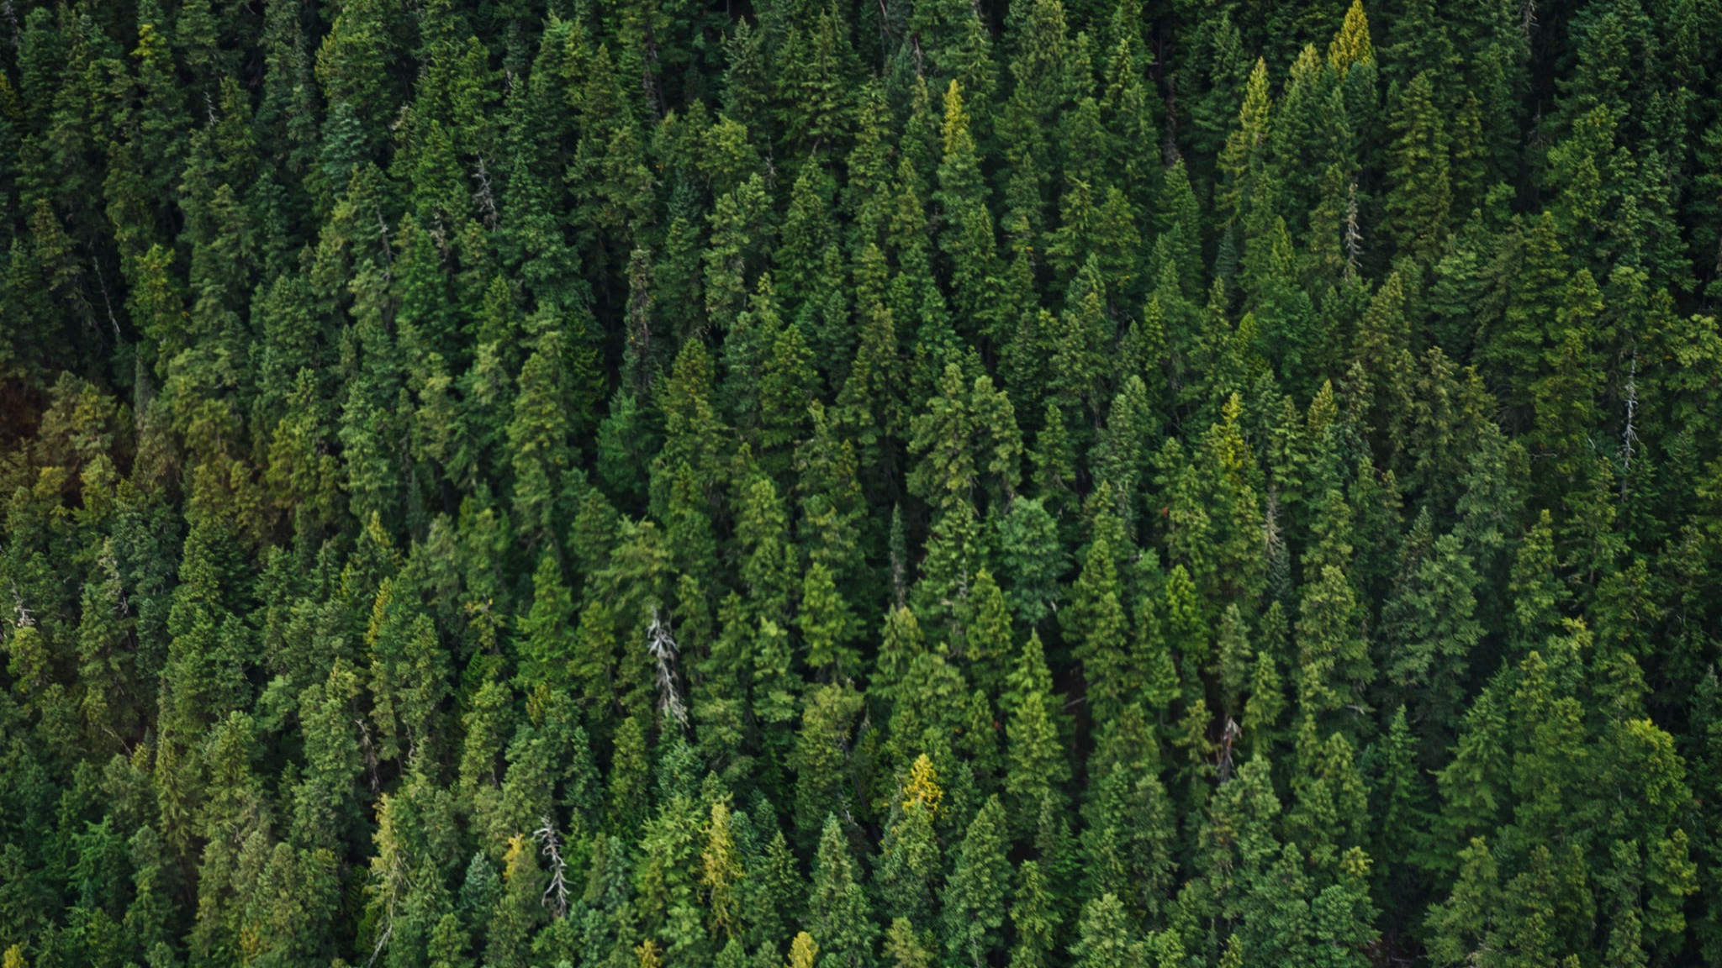
Insect Biomass & Red-Listed Species
In Bavaria, Germany
Arlette, Tyler, Andrei

Slide 2
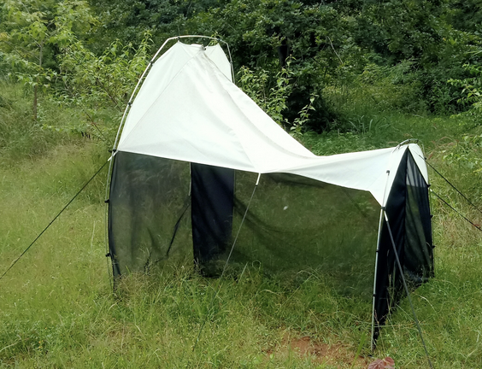
Introduction
Landscape Types
Plot Types
Section
12
Malaise traps were set out on land plots to collect insects, the biomass of these collected insects and the number of red-listed (threatened) species was recorded.
⬤ Agricultural
⬤ Urban
⬤ Semi-Natural
⬤ Forest
⬤ Meadow
⬤ Arable Field
⬤ Settlement

Slide 3
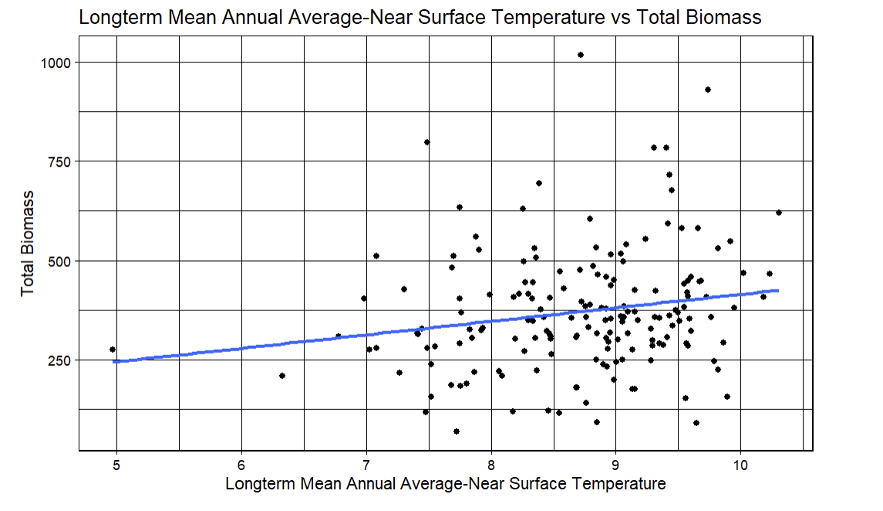
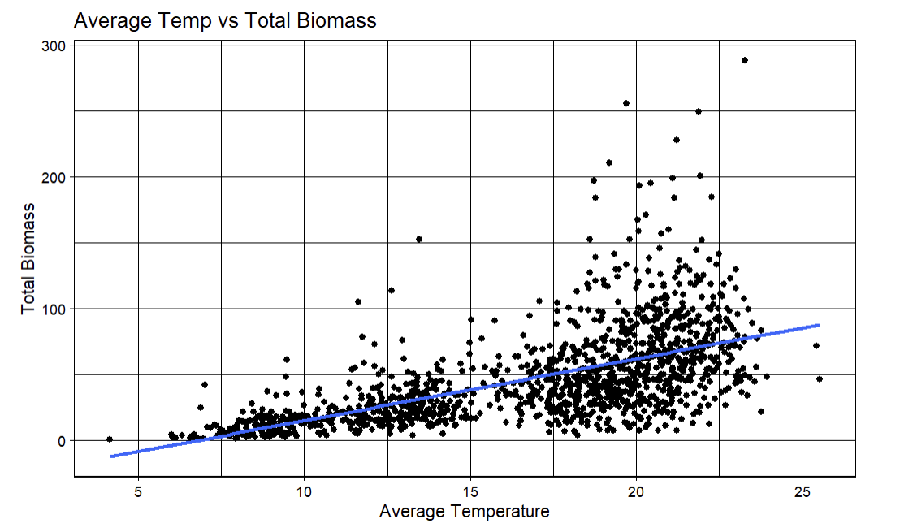
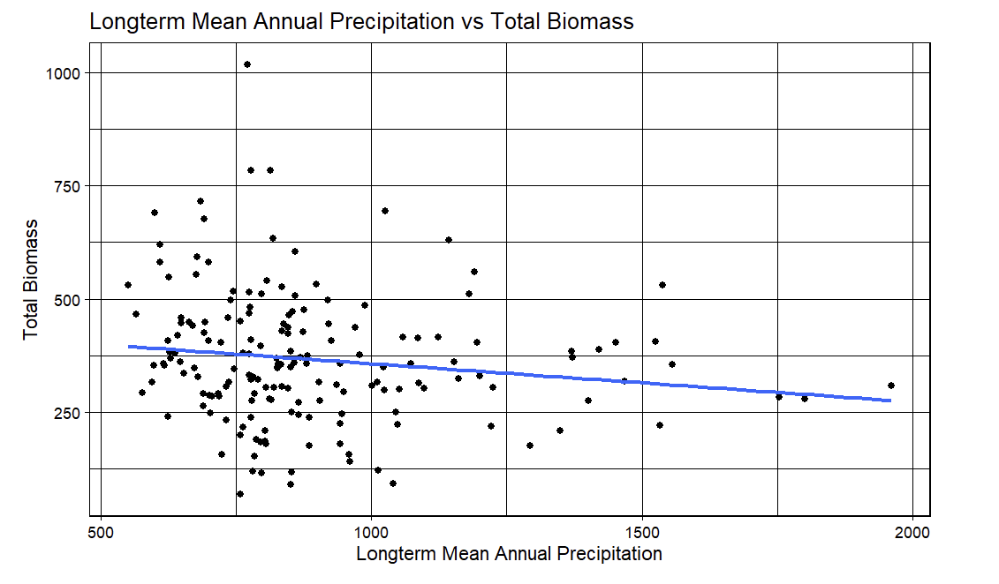
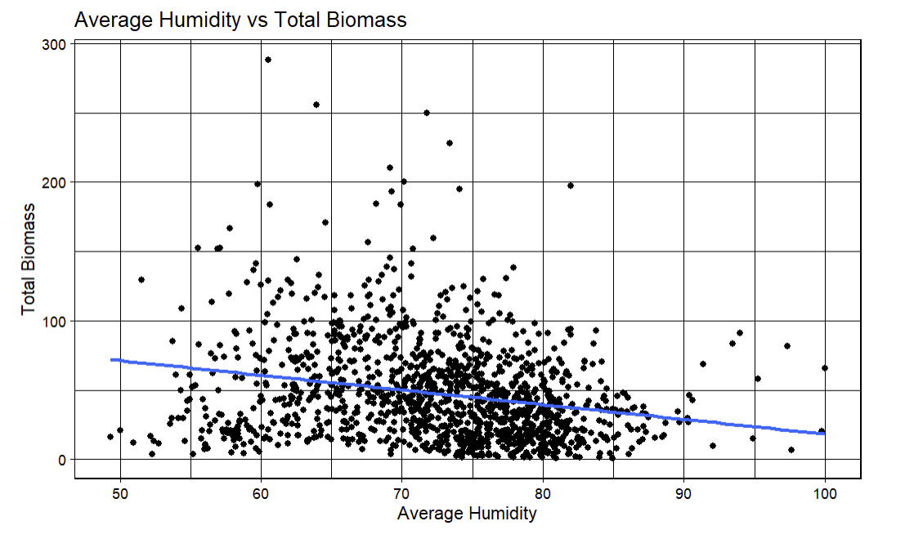
Comparing Biomass to Temp/Humidity

Slide 4
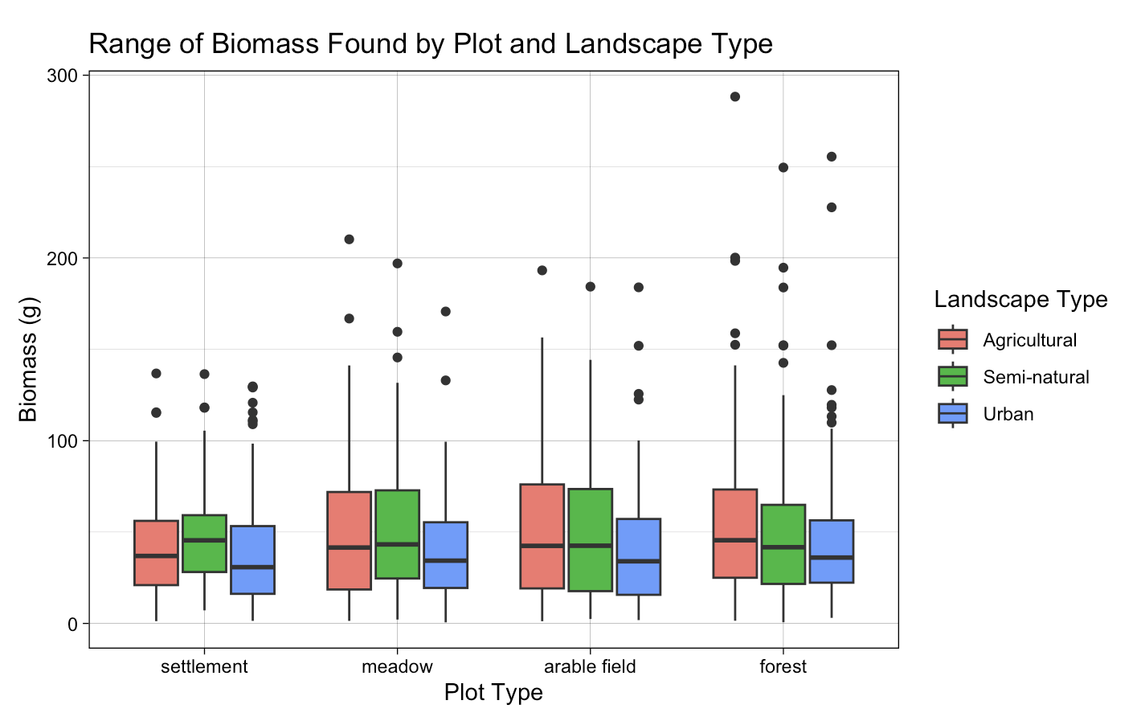
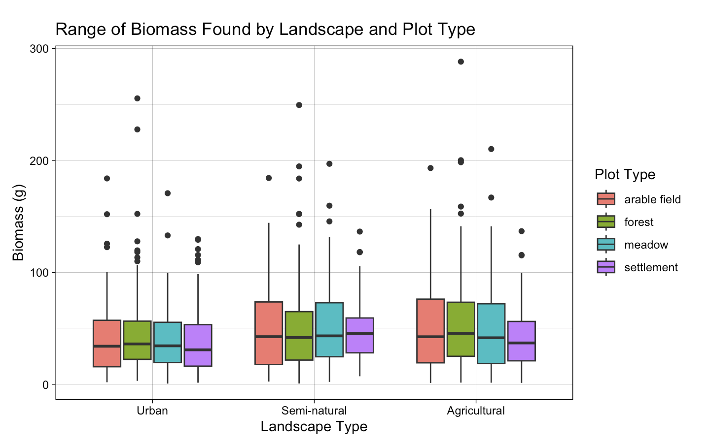
Range of Biomass Collected Across Plot and Landscape Types

Slide 5
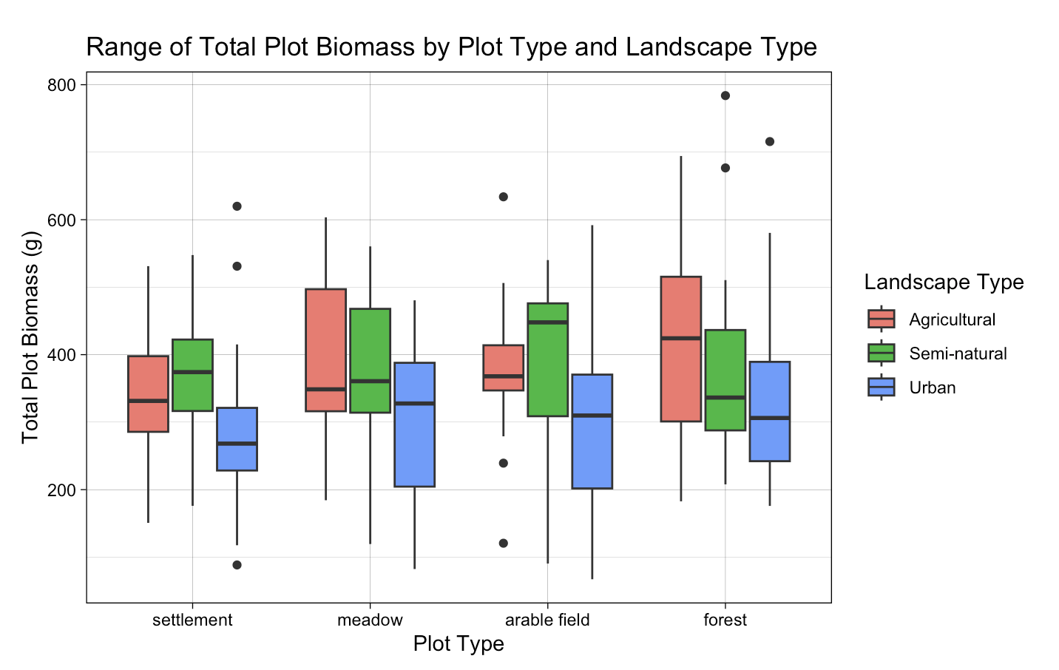
Range of Total Plot Biomass Across Plot and Landscape Types

Slide 6
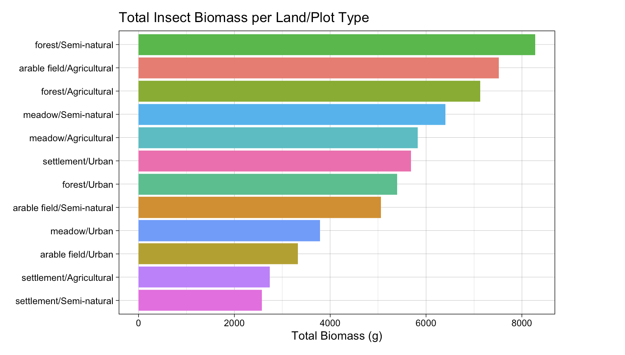
Total Insect Biomass Per Land/Plot Type

Slide 7
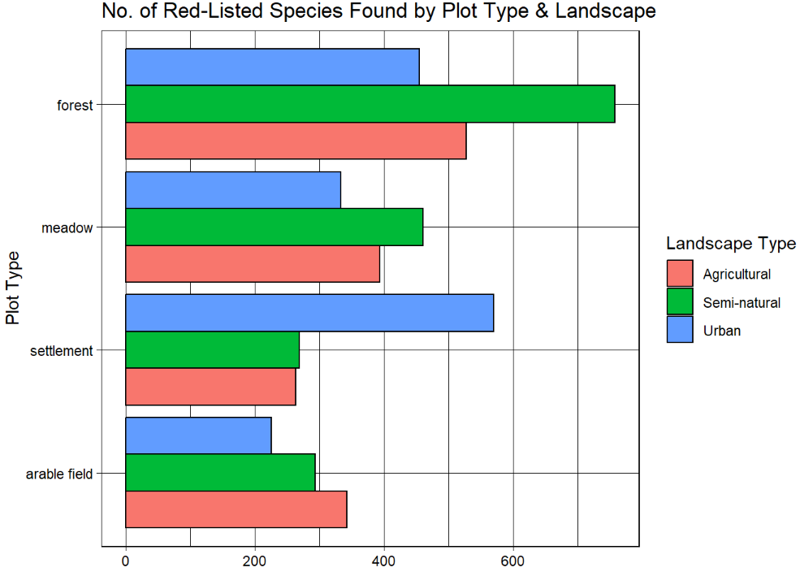
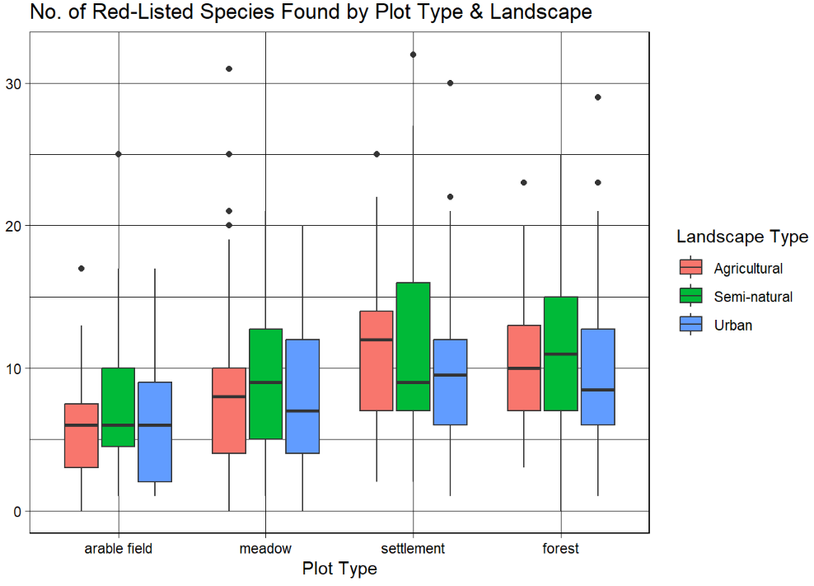
No. of Red-Listed Species by Plot and Landscape Type

Slide 8
Conclusion
No obvious hidden causal factors from weather.
Urban areas had the lowest total biomass but agricultural land & especially arable fields had the lowest no. of red-listed species.
Semi-natural forests had the highest total biomass & no. of red-listed species.

Slide 9
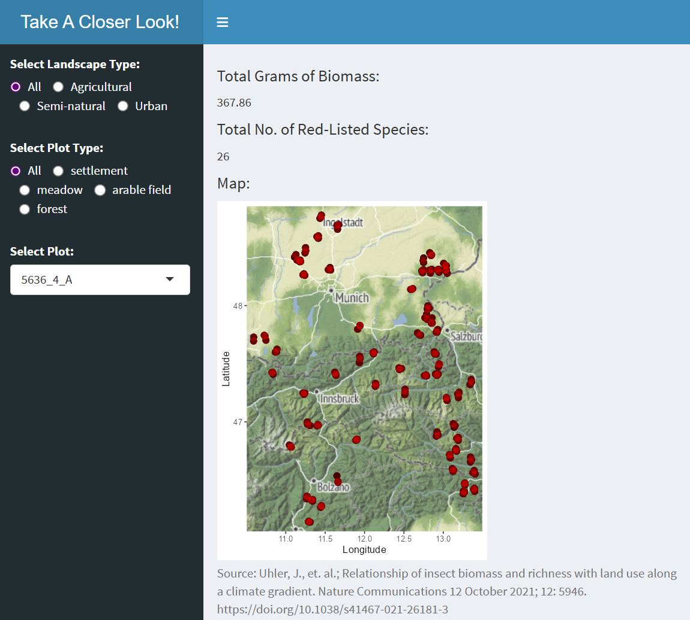
Shiny App

